Slide 1
DOEHRS-IH (EH)
New Manage Water Systems Role

Slide 2
New Manage Water Systems Data Role
DOEHRS-IH Production announced the release of the latest Version 2.1.2.0
With this update new permissions and actions are now necessary by Senior PMA in order to input data for water samples.
A new required field has been established and must be completed before sample can be saved and QA conducted.

Slide 3
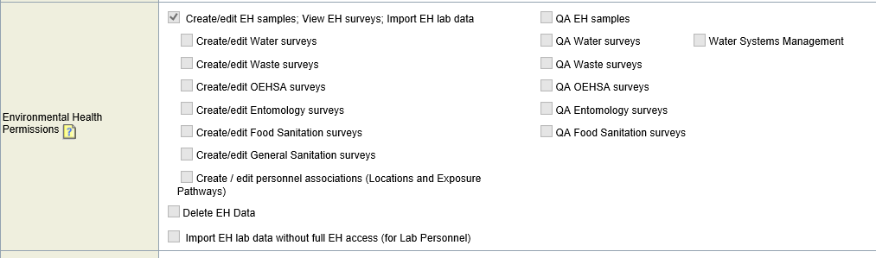
New Manage Water Systems Data Role
New role “Water Systems Management” added under Environmental Health Permissions

Slide 4
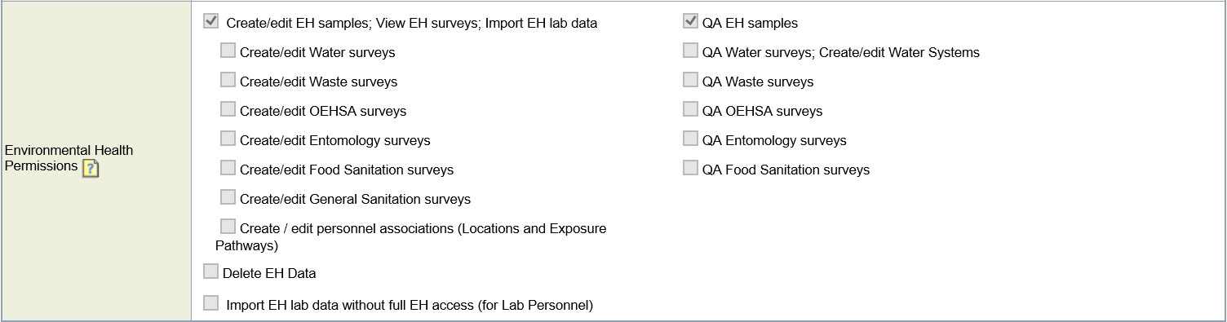
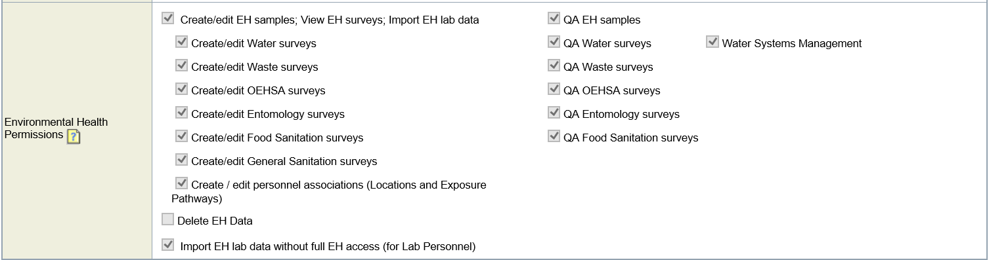
New Manage Water Systems Data Role
'QA Water surveys; Create/edit Water Systems’ now displays as 'QA Water Surveys’
  Roles will transfer to accounts for those who already had them
OLD
NEW

Slide 5
New Manage Water Systems Data Role
New role “Water Systems Management” added under Environmental Health Permissions appears on the following forms:
  My Profile
  New Account Request
  Request Access to New Program Office
  Request Permission Updates (Current Program Office)
  Program Office Personnel - Detail

Slide 6
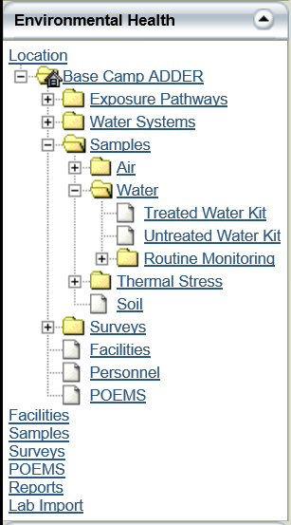
New Manage Water Systems Data Role
Water Sample page affected:
  EH - Treated/Untreated Water Kit

Slide 7
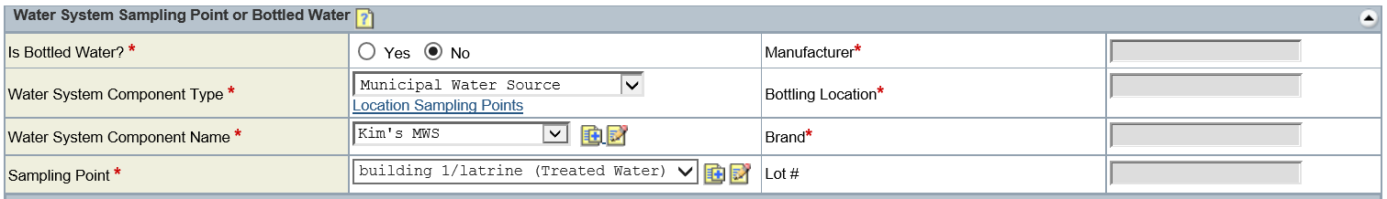
New Manage Water Systems Data Role
Affects Sampling Point tile
  With the new role you can add and edit
    Water System Component Names
    Sampling Points
  WSC Name
    Without the role you will not see the add/edit icons
  Sampling Point
    Without the role you will not see the add icon

